Slide 1



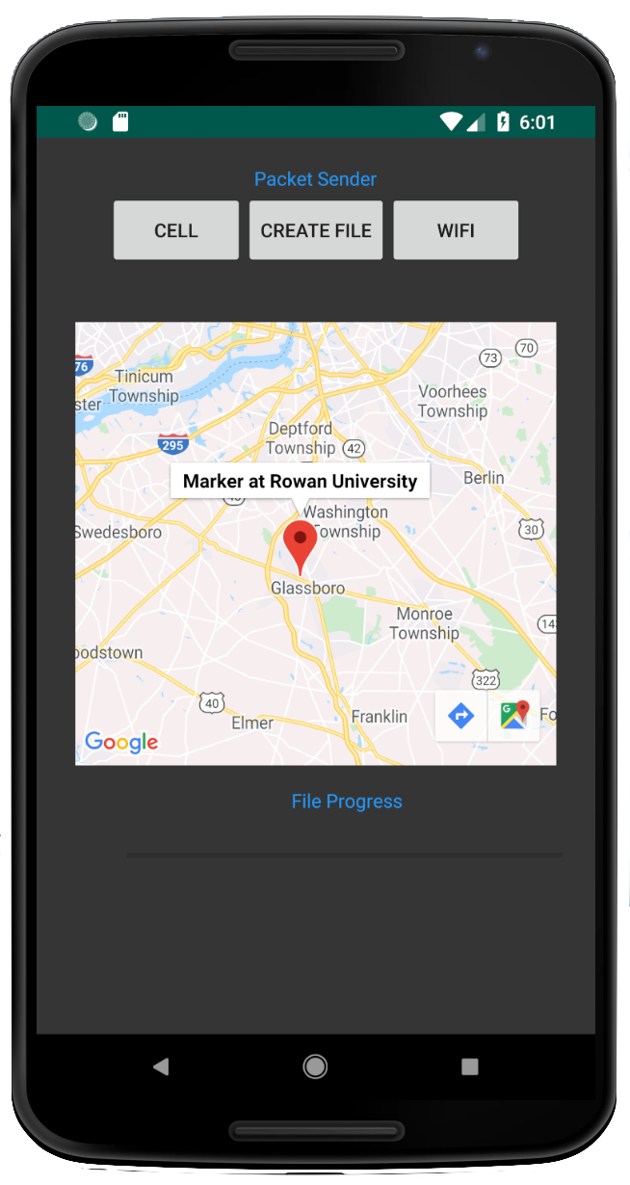
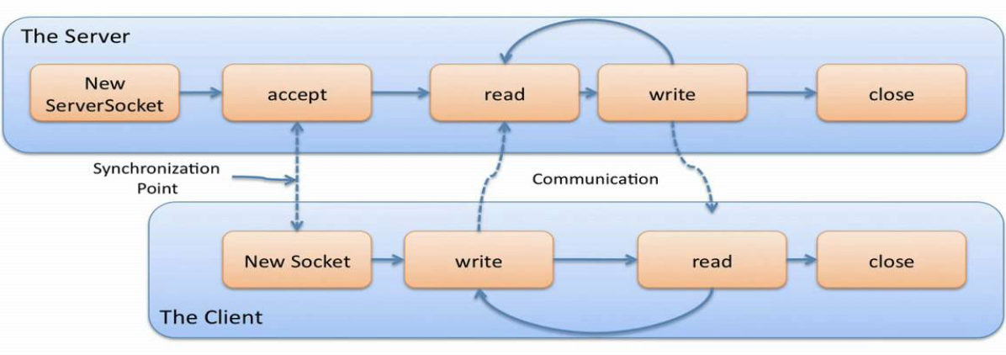
An Experimental Study of Cellular Data Offloading in Urban and University Scenarios
Jeffery Wang and Ning Wang
Department of Computer Science, Rowan University, Glassboro, USA
Introduction
One limiting factor that slows down our connectivity is latency, through cellular and WiFi connections within different environments.
There are a ton of opportunity's to find more cost-efficient for network related tasks.
we explored how much data can be offloaded to the WiFi networks in the delay-sensitive applications in Urban and University scenarios.
Figure 1 Philadelphia
Mobile offloading
Xfinity WiFi Hotspots
Figure 1 Rowan University
Methodology
Results and Discussions
We built a networked system, i.e., a smartphone application and a backend server, to conduct experiments.
The Cumulative Distribution Function (CDF) results of latency measurement by using the proposed testbed are shown in
figure 2.
We observed that the data latency in both interfaces increases along with the packet sizes. In addition, the WiFi interface is more sensitive compared with the cellular interface in both scenarios.
Java Socket Server flow
The first method used was measuring specifically the time server side by sending two packets: one to establish the connection through a ping, and one possessing the actual data. The time was then measured for both packets to be received to give the RTT of the data.
The sequential method took out the initial ping and instead sends a file via a threaded socket server. On the server side it takes files send form the phone and tracks the time the connection is established to when the file is fully received.
When collecting the data two smartphones were used simultaneity. One to send packets via cellular, while the other over the WiFI interface. We used Xfinity WiFi hotspots to collect data for out WiFi interface around the city.
Figure 2. Philadelphia
Figure 2. Rowan University
The WiFi interface has a much larger latency in the center city, Philadelphia. However, the WiFi interface has a smaller latency at Rowan University.
Reference
Future Works
Engelsma, J. (2005). [Image]. Retrieved from https://images.app.goo.gl/sBU853Mjj5Pu8fwo6
We established a networked testbed to measure the smartphone’s connection latency on both interfaces. The results show that different locations have different latency's.
Ahmad, M. (2018). Description of Mobile Data Offloading [Image]. Retrieved from https://www.researchgate.net/figure/Description-of-Mobile-Data-Offloading_fig2_326030064
Our future work is to propose data offloading algorithm to optimally determine the data offloading strategies.

